Slide 1




Hexaware CODE&RISE PROGRAM
Techdynamites_Jeppiaar_Engg
Powering Innovation

Slide 2
Team Details
Team Name : Techdynamites_Jeppiaar_Engg
Application Name : RideShare Application
Team Members
Email ID
Karthikeyan V
karthikeyanvasu03@gmail.com
Reshma M
reshmamuthu411@gmail.com
Dhivya G
dhivyaganapathi2004@gmail.com
Aarthi J
aarthij71@gmail.com

Slide 3

Impact/Potential Value of the Application
For Riders:
Cost-effective:
Rideshare and carpooling can be significantly cheaper than traditional taxis or private car ownership.
Convenience:
Users can easily book rides through their smartphones and track their drivers in real-time.
Flexibility:
Rideshare and carpooling offer flexible options for different travel needs, including on-demand rides, scheduled rides, and long-distance trips.
Reduced environmental impact:
By sharing rides, users can help reduce traffic congestion and greenhouse gas emissions.
Social connections:
Rideshare and carpooling can provide opportunities to meet new people and build social connections.

Slide 4
Impact/Potential Value of the Application
For Drivers:
Earn Extra Income:
Drivers can supplement their income by offering rides during their free time.
Flexible Hours:
Drivers can set their own schedules and choose when and where they want to drive.
Tax Benefits:
In some regions, drivers may be eligible for tax deductions related to their rideshare or carpooling activities.
Meet New People:
Drivers can interact with a variety of people from different backgrounds.

Slide 5
Impact/Potential Value of the Application
For Community:
Reduced Traffic Congestion:
Rideshare and carpooling can help reduce traffic congestion and improve transportation efficiency.
Reduced Pollution:
By reducing the number of vehicles on the road, rideshare and carpooling can improve air quality.
Economic Benefits:
Rideshare and car pooling can create jobs and stimulate economic growth.
Social Benefits:
Rideshare and carpooling can faster a sense of community and social connection.

Slide 6
The Solution Proposed by your Team
Solution Highlights
Personalized Matching: Utilizes GIS, ML, and NLP to match riders and drivers based on their preferences, routes, and historical data.
Efficient Routing: Employs shortest path algorithms and real-time traffic updates to optimize routes and minimize travel time.
Transparent communication: Provides clear and concise information through document generation and real-time tracking.
User-friendly experience: Leverages Google Maps integration for easy navigation and navigation.
NLP for Sentiment Analysis: Analyzes rider and driver feedback using NLP to identify areas for improvement.

Slide 7
The Solution Proposed by your Team
Solution Proposed
Rider and Driver Inputs
Rider:
Pickup location
Destination
Number of passengers
Preferred time
Additional requirements (e.g., pet-friendly, luggage)
Driver:
Available time slots
Vehicle type
Maximum number of passengers
Preferred routes
GIS-Based Similarity Score
Route Similarity:
Use GIS algorithms to calculate the similarity between the rider's route and the driver's potential routes based on factors like distance, travel time, and road conditions.
Spatial Optimization:
Consider factors like traffic congestion, road closures, and construction zones to optimize the route.

Slide 8
The Solution Proposed by your Team
Solution Proposed
ML Model for Match Prediction
Historical Data:
Train a machine learning model on historical ride data to predict the best matches based on factors like rider preferences, driver availability, and route similarity.
Feature Engineering:
Consider features such as rider ratings, driver ratings, and previous match success to improve prediction accuracy.
NLP for Sentiment Analysis
Feedback analysis:
Use NLP techniques to analyze the sentiment of rider and driver feedback to identify areas for improvement and maintain a positive user experience.
Real-time Ride Tracking
GPS integration:
Use GPS technology to track the rider's and driver's location in real-time.
ETA updates:
Provide riders with accurate estimated arrival times based on traffic conditions and route updates.
Shortest Path Algorithm
Initial route:
Use a shortest path algorithm (e.g., Dijkstra's algorithm) to determine the initial route between the pickup and destination.
Dynamic updates:
Update the route in real-time based on traffic conditions and other factors.

Slide 9
Technologies Used
Core Technologies
Mobile App Development:
iOS: Swift
Swift is a powerful and intuitive programming language for all Apple platforms. Swift, has a concise-yet-expressive syntax and modern features.
Android: Kotlin
Kotlin is a cross-platform, statically typed, general-purpose high-level programming language with type inference.
Backend development:
Programming language: Python
Python is a high-level, general-purpose programming language. Its design philosophy emphasizes code readability with the use of significant indentation.
Framework: Django
Django is a free and open-source, Python-based web framework that runs on a web server. It follows the model–template–views architectural pattern.
Cloud platform: Google Cloud Platform
Google Cloud Platform is a suite of cloud computing services offered by Google that provides a series of modular cloud services including computing, data storage, data analytics, and machine learning, alongside a set of management tools.

Slide 10








Technologies Used
Specific Technologies
Geographical Information System
Mapbox
Machine Learning
Scikit-learn
Natural Language Processing
NLTK
Real-time Tracking
Firebase Realtime Database
Payment Gateway
Stripe
Authentication and Authorization
Firebase Authentication
Mapping
Google Maps API
Document Generation
ReportLab

Slide 11



Gen AI Tool Utilization
Natural Language Processing (NLP) Tools
Hugging Face Transformers
spaCy
NLTK (Natural Language Toolkit)
Generative Models
TensorFlow and PyTorch
Hugging Face Transformers
Recommendation Systems
Surprise
LightFM
Implicit
Predictive Analytics
Scikit-learn
Statsmodels

Slide 12
System Architecture, Functionalities and Design Diagram
Functionalities
User Registration: Allows users to create accounts and provide personal information.
Ride Request: Enables users to request rides, specifying pickup and drop-off locations, time, and preferences.
Driver Onboarding: Facilitates driver registration and verification.
Matchmaking: Matches riders with suitable drivers based on factors like location, time, and preferences.
Route Optimization: Calculates the optimal route between pickup and drop-off locations using GIS services.
Real-time Tracking: Tracks the progress of rides in real-time using GPS.
Payment Processing: Handles payments using a secure payment gateway.
Feedback and Ratings: Allows users to provide feedback and ratings for drivers and rides.
Analytics: Provides insights into usage patterns, driver performance, and customer satisfaction.

Slide 13
System Architecture, Functionalities and Design Diagram
Data Flow and Process Steps
User Registration: Users create accounts and provide personal information.
Ride Request: Users request rides, specifying pickup and drop-off locations, time, and preferences.
Matchmaking: The system matches riders with suitable drivers based on location, time, and preferences using machine learning algorithms.
Route Optimization: The system calculates the optimal route using GIS services, considering factors like traffic conditions and road closures.
Ride Initiation: The driver is notified of the ride and starts the journey.
Real-time Tracking: The system tracks the progress of the ride using GPS and provides updates to the rider and driver.
Payment Processing: The system processes the payment using a secure payment gateway..
Feedback and Ratings: Users can provide feedback and ratings for the ride and driver.
Analytics: Provides insights into usage patterns, driver performance, and customer satisfaction.

Slide 14
System Architecture, Functionalities and Design Diagram
Components and Interactions
Data Pipeline, APIs, and External Services
User Interface: The frontend component that interacts with users, allowing them to request rides, track progress, and provide feedback.
Data Pipeline: Involves collecting, processing, and storing data from various sources, including user interfaces, GPS devices, and external APIs.
Backend Server: The server-side component that handles business logic, including matchmaking, route optimization, payment processing, and data storage.
APIs: The system may use APIs from external services, such as Google Maps, for mapping and routing, and payment gateways for processing payments.
Database: Stores user data, ride information, driver profiles, and other relevant data.
External Services: The system may integrate with external services, such as social media platforms for user authentication or messaging services for notifications.
GIS Services: Provides mapping, routing, and geocoding functionalities.
Machine Learning Models: Used for matchmaking, predictive analytics, and other tasks.
Payment Gateway: Handles payment processing and security.
Real-time Tracking: Uses GPS and other technologies to track the progress of rides.
Analytics Tools: Collects and analyzes data to provide insights.

Slide 15
Process Flow Diagram
RIDER FLOWCHART
DRIVER FLOWCHART
Login
Pickup Location
Destination
Timing
Ride Type
Matching
Payment
Feedback
Login
License Verification
Starting Point
Receive Ride Request
Accept or Decline Ride Request
Tracking till destination
Payment
Feedback

Slide 16
How it works
Functional Architecture
Functional Flow:
Data Flow:
User Registration
Ride Request
Matchmaking
Route Optimization
Ride Initiation
Real-time Tracking
Payment Processing
Feedback and Ratings
Analytics
User Data: Collected during registration and stored in the database.
Ride Requests: Stored in the database along with rider and driver information.
Location Data: Collected from GPS devices and stored in the database.
Route Data: Calculated using GIS services and stored in the database.
Payment Information: Stored securely in the payment gateway.
Feedback and Ratings: Stored in the database for analysis.

Slide 17
How It Works
Technical Architecture
Key Components:
Key Interactions:
Frontend:
Mobile App: Kotlin
Backend Server:
Programming Language: Python
Framework: Django or Flask
Database:
Relational Database: PostgreSQL or MySQL
NoSQL Database: MongoDB
Location Services:
Google Maps API: For mapping, routing, and geocoding.
Machine Learning:
TensorFlow or PyTorch.
Scikit-learn
Payment Gateway
Stripe, PayPal, or Braintree: For secure payment processing.
Communication Channels:
Firebase Realtime Database: For real-time updates and notifications.
External Services:
Twilio or SendGrid: For SMS and email notifications.
Frontend with Backend Server: The frontend sends requests to the backend server, which processes them and returns the necessary data.
Backend Server with Database: The backend server interacts with the database to store, retrieve, and update data.
Backend Server with Google Maps API: The backend server uses Google Maps API for mapping, routing, and geocoding.
Backend Server with Machine Learning Models: The backend server uses machine learning models for matchmaking, route optimization, and predictive analytics.
Backend Server with Payment Gateway: The backend server integrates with the payment gateway to process payments.
Backend Server with Firebase Realtime Database: The backend server uses Firebase Realtime Database for real- time updates and notifications.

Slide 18
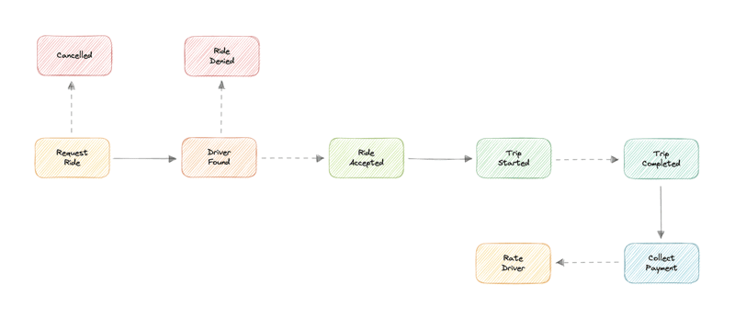
How It Works
Service Workings:

Slide 19
Innovation and Creativity
Key Innovations:
Creative Elements:
Personalized Matching: Leveraging machine learning algorithms and user data to match riders and drivers based on preferences, routes, and historical behavior.
Real-time Tracking and Updates: Providing real-time updates on ride status, estimated arrival times, and route changes using GPS technology and Firebase Realtime Database.
Dynamic Pricing: Implementing dynamic pricing models to adjust fares based on demand and supply, ensuring optimal pricing for both riders and drivers.
Efficient Route Optimization: Utilizing GIS services and advanced routing algorithms to optimize routes, minimizing travel time and fuel consumption.
Integrated Payment Solutions: Providing seamless payment processing through secure payment gateways, offering convenience to users.
User-Centric Design: Prioritizing user experience by designing intuitive interfaces, providing clear information, and offering personalized features.
Community Building: Fostering a sense of community among riders and drivers through features like social sharing and feedback mechanisms.
Gamification: Incorporating gamification elements, such as rewards or challenges, to encourage user engagement and loyalty.
Social Features: Enabling users to connect with friends, share rides, and participate in social events.
Eco-Friendly Initiatives: Promoting sustainable transportation by offering incentives for carpooling and electric vehicle usage.
Innovative Marketing Campaigns: Utilizing targeted marketing strategies and partnerships to attract new users and expand the reach of the application.
Customization Options: Allowing users to personalize their app experience through themes, settings, and preferences.

Slide 20
Scalability, Performance and Security
Scalability
Performance
Security
Horizontal Scaling: The application should be designed to scale horizontally by adding more servers to handle increased load.
Cloud-Based Infrastructure: Utilizing cloud platforms like GCP can provide flexibility and scalability.
Microservices Architecture: Breaking down the application into smaller, independent services can improve scalability and maintainability.
Caching: Implementing caching mechanisms to store frequently accessed data in memory, reducing database load and improving response times.
Optimization: Optimizing code, database queries, and network communication to improve performance.
Asynchronous Processing: Using asynchronous programming techniques to handle multiple tasks concurrently, improving responsiveness.
Content Delivery Network (CDN): Distributing static content across multiple servers to reduce latency and improve load times.
Load Balancing: Distributing traffic across multiple servers to prevent bottlenecks and improve performance.
Data Encryption: Encrypting sensitive data, such as user information and payment details, to protect it from unauthorized access.
Authentication and Authorization: Implementing robust authentication and authorization mechanisms to control access to different parts of the application.
Input Validation: Validating user input to prevent security vulnerabilities like SQL injection and cross-site scripting (XSS).
Regular Updates and Patches: Keeping the application and its dependencies up-to-date with the latest security patches.
Security Audits: Conducting regular security audits to identify and address potential vulnerabilities.
Data Backup and Recovery: Implementing a robust data backup and recovery plan to protect against data loss.

Slide 21
Best practices and industry standards followed
User Experience (UX):
Safety and Security:
Reliability and Performance:
Intuitive Interface: Design a user-friendly interface that is easy to navigate and understand.
Clear Communication: Provide clear and concise information to users throughout the ride-hailing process.
Personalized Experience: Offer personalized features and recommendations based on user preferences and history.
Feedback Loop: Encourage user feedback and implement improvements based on customer insights.
Driver Verification: Implement rigorous driver verification processes to ensure the safety of riders.
Emergency Assistance: Provide easy access to emergency assistance features within the app.
Data Privacy: Protect user data and comply with relevant data privacy regulations (e.g., GDPR, CCPA).
Security Measures: Implement robust security measures to prevent unauthorized access and data breaches.
Real-time Tracking: Provide accurate real-time tracking of rides and estimated arrival times.
Reliable Matching: Develop efficient algorithms for matching riders and drivers.
Scalability: Ensure the application can handle increasing user demand and scale accordingly.
Performance Optimization: Continuously optimize the application for speed and efficiency.

Slide 22
Best practices and industry standards followed
Customer Service:
Industry Standards:
Responsive Support: Provide timely and helpful customer support channels (e.g., in-app chat, email, phone).
Problem Resolution: Address customer issues promptly and effectively.
Proactive Support: Anticipate customer needs and provide proactive assistance.
ISO 27001: Implement an information security management system to ensure data protection.
PCI DSS: Comply with Payment Card Industry Data Security Standard if handling credit card payments.
ADA Compliance: Ensure the app is accessible to users with disabilities, complying with the Americans with Disabilities Act.
Accessibility Standards: Adhere to other relevant accessibility standards, such as WCAG (Web Content Accessibility Guidelines).
Legal and Regulatory Compliance:
Local Regulations: Adhere to local transportation regulations and licensing requirements.
Insurance: Maintain appropriate insurance c overage for drivers and passengers.
Tax Compliance: Comply with tax laws and regulations in the operating regions.

Slide 23
User Experience
Ease of Use
Intuitive Interface
Simple Booking Process
Clear Information
Safety and Security
Verified Drivers
Emergency Assistance
Data Privacy
Reliability and Performance
Accurate Tracking
Reliable Matching
Fast Loading Times
Payment Convenience
Multiple Payment Options
Easy Payment Processing
Communication and Support
In-App Messaging
Customer Support
Clear Notifications
Personalized Experience
Saved Locations
Ride Preferences
Recommendations
Community Features
Social Sharing
Referrals

Slide 24
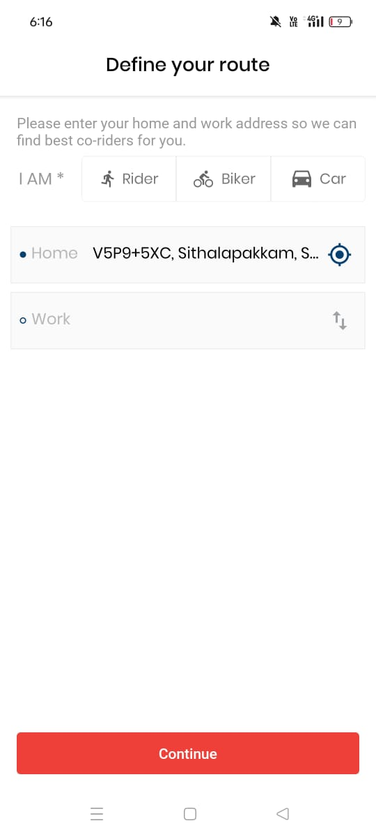
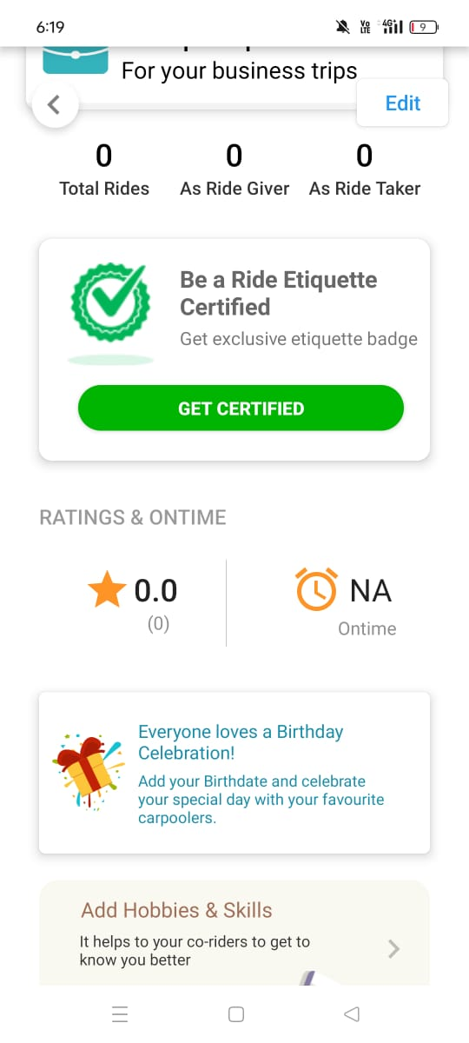
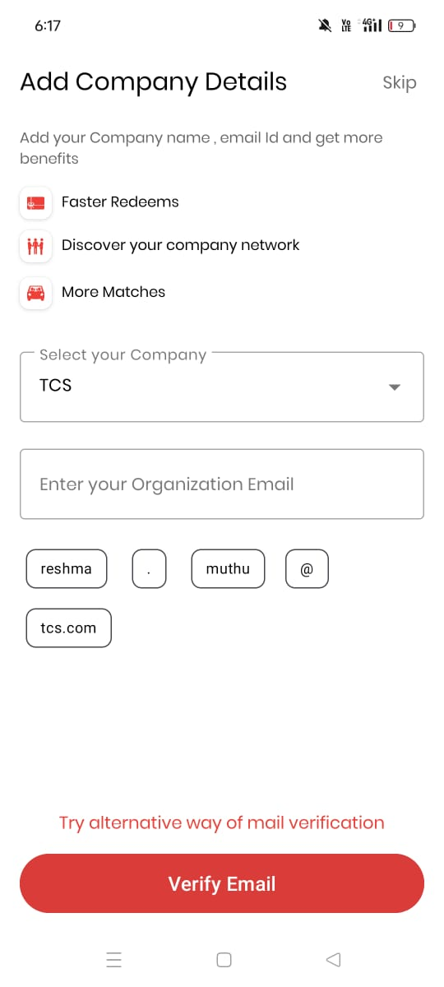
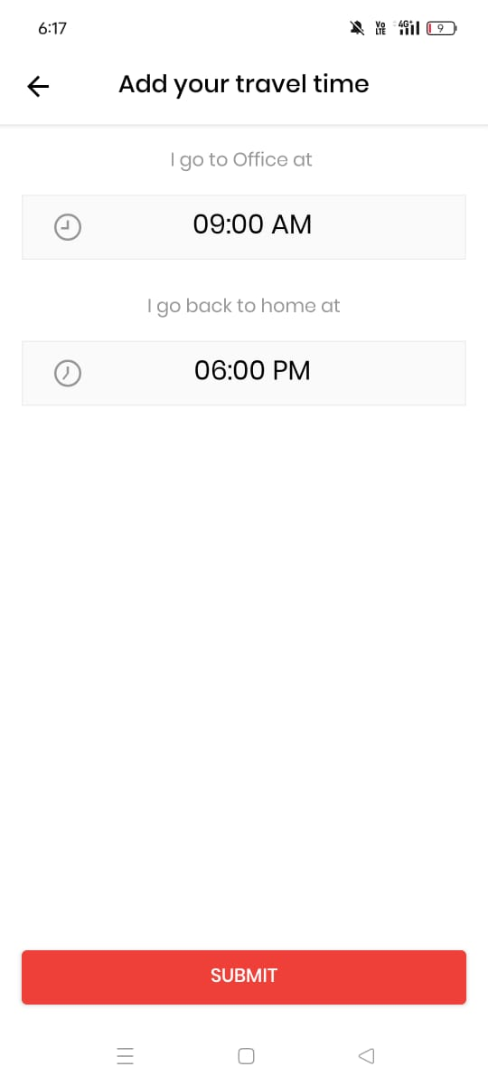
Console Output Details
GitHub Links :
Team Member 1 - https://github.com/Reshma411/Ride-Share-Application-
Team Member 2 - https://github.com/Dhivyaganapathi/Ride-Share-Application-.git
Team Member 3 - https://github.com/Aarthi289312/Ride-share-application-.git
Team Member 4 - https://github.com/DevilNReality/Hexaware-Hackathon

Slide 25
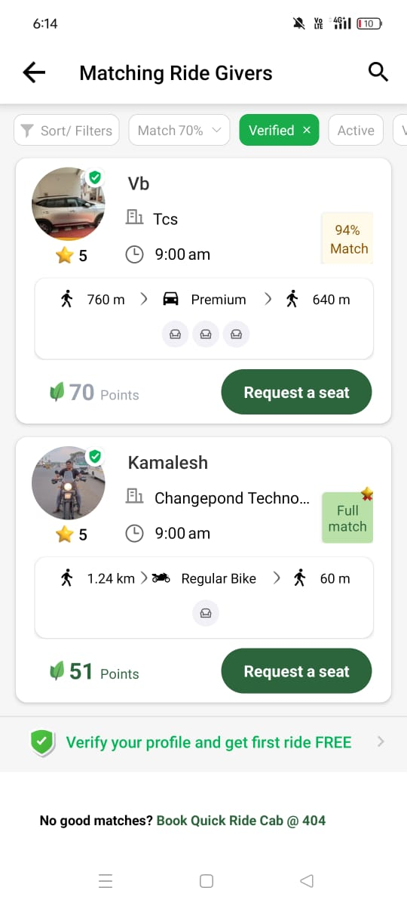
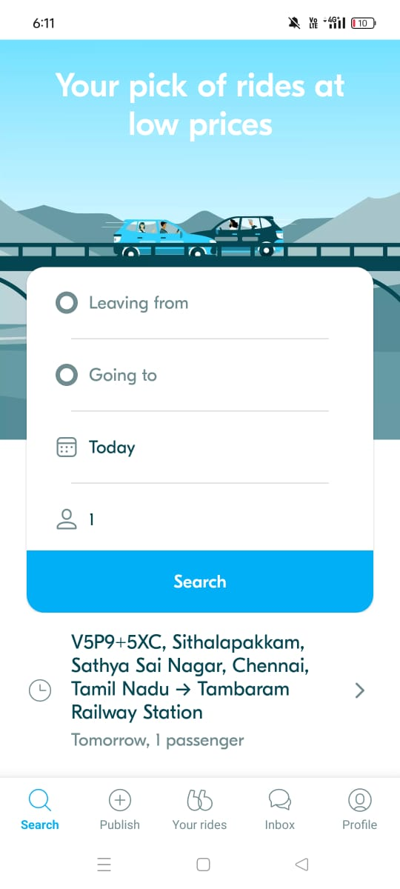
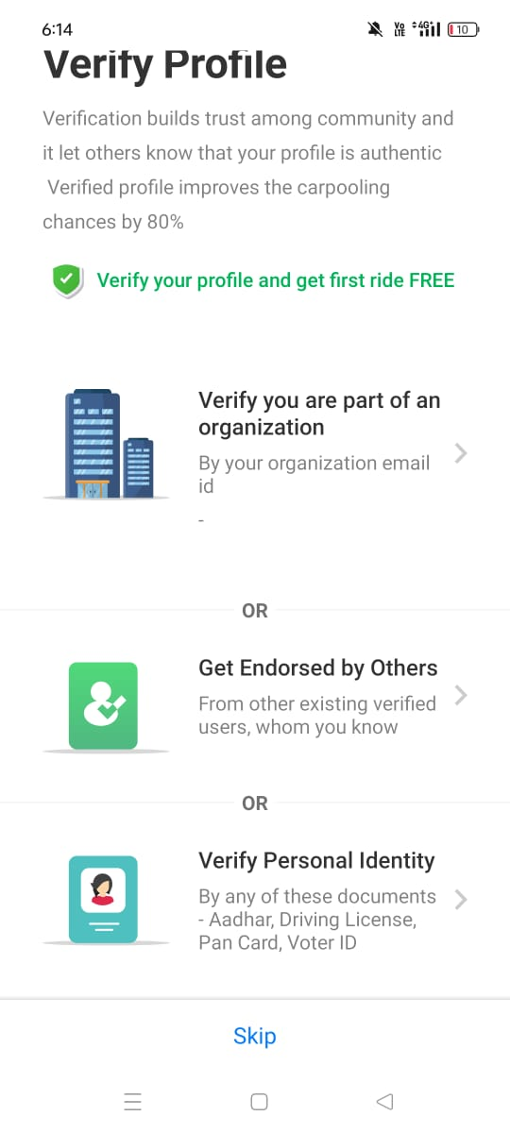
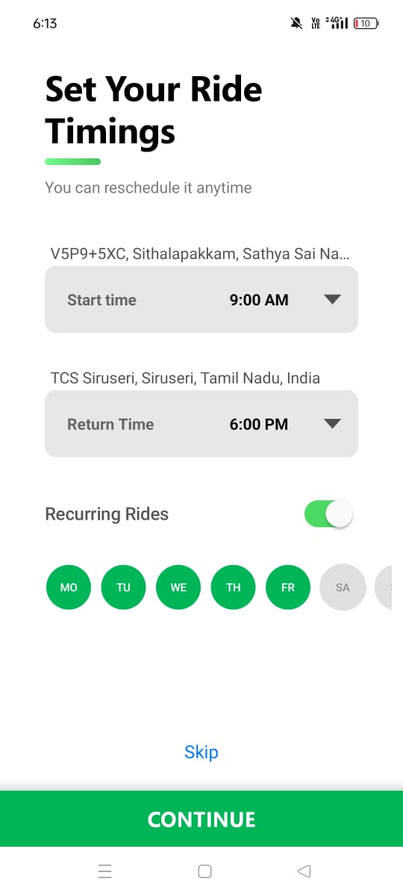
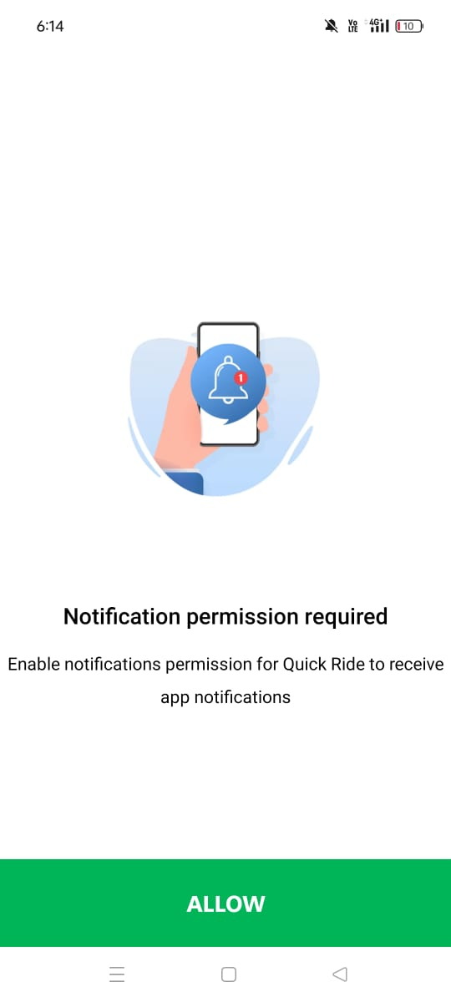
Console Output Details

Slide 26
Phase 1 - Judging Criteria
Solution Approach
Usage of Gen AI tools
Solution Feasibility
Technical Approach/Architecture Design
Innovation and Creativity
User Experience
Documentation and Presentation
Console Output

Slide 27
Thank You

